Slide 1
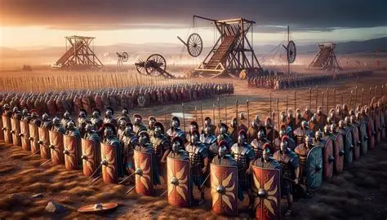
“The Weapons and Armour of our Christian Warfare – Part 2”
Thurrock Christian Fellowship
14th June 2026
By Andy Acreman

Slide 2
Today’s Agenda
Reminder of Part 1’s teaching
Whose battle is it?
Understanding each part of our armour
What is ‘Praying in the Spirit’?
The Gospel and our warfare
Summary

Slide 3
“From Now On… The Bottom Line Is…”
Ephesians 6:10-13 NIV
¹⁰ Finally, be strong in the Lord and in his mighty power. ¹¹ Put on the full armour of God, so that you can take your stand against the devil’s schemes. ¹² For our struggle is not against flesh and blood, but against the rulers, against the authorities, against the powers of this dark world and against the spiritual forces of evil in the heavenly realms. ¹³ Therefore put on the full armour of God, so that when the day of evil comes, you may be able to stand your ground, and after you have done everything, to stand.

Slide 4
Stand!… Stand!… Stand!
Ephesians 6:10-13 NIV.
¹⁰ Finally, be strong in the Lord and in his mighty power. ¹¹ Put on the full armour of God, so that you can take your stand against the devil’s schemes… ¹³ Therefore put on the full armour of God, so that when the day of evil comes, you may be able to stand your ground, and after you have done everything, to stand.
James 4:7 NIV. Submit yourselves, then, to God. Resist the devil, and he will flee from you.
1 Peter 5:8-9 NIV. Be alert and of sober mind. Your enemy the devil prowls around like a roaring lion looking for someone to devour. 9 Resist him, standing firm in the faith.

Slide 5
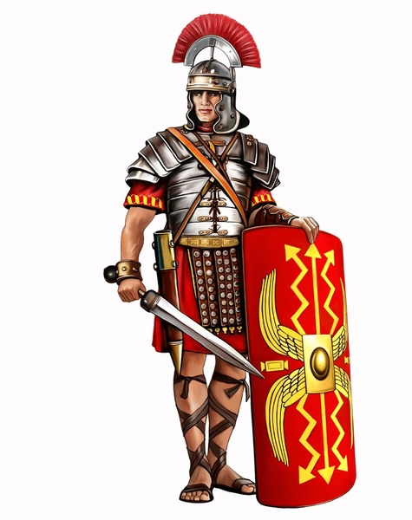
Six Pieces of Armour - in Two Groups of Three
PUT ON…
TRUTH – as a belt
RIGHTEOUSNESS – as a breastplate
READINESS OF THE GOSPEL OF PEACE – as footwear
TAKE UP…
FAITH – as a shield
THE HOPE OF SALVATION – as a helmet
THE SPIRIT’S WORD / GOD’S WORD – as a sword

Slide 6
PUT ON…

Slide 7
TRUTH – as a belt
‘Truth’ means the whole Word of God, the entire revelation of the scriptures, the full gospel of our salvation.
John 8:31-32 ESV. So Jesus said to the Jews who had believed him, "If you abide in my word, you are truly my disciples, ³² and you will know the truth, and the truth will set you free."
John 17:17 NIV. Sanctify them by the truth; your word is truth.
Ephesians 1:13 ESV. In him you also, when you heard the word of truth, the gospel of your salvation, and believed in him…
2 Timothy 2:15 NIV. Do your best to present yourself to God as one approved, a worker who does not need to be ashamed and who correctly handles the word of truth.
Revelation 19:11,13 NIV. I saw heaven standing open and there before me was a white horse, whose rider is called Faithful and True. With justice he judges and wages war... ¹³ He is dressed in a robe dipped in blood, and his name is the Word of God.

Slide 8
RIGHTEOUSNESS – as a breastplate
‘Righteousness’ means the righteousness that God gives us. That which Christ gave to us from the Cross. Justification by faith alone. The price Jesus paid to the Father on our behalf was to take away our sins and to give us this positive righteousness – being declared acceptable by God.
Philippians 3:8-9 NIV. …that I may gain Christ 9 and be found in him, not having a righteousness of my own that comes from the law, but that which is through faith in Christ—the righteousness that comes from God on the basis of faith.
2 Corinthians 5:21 NIV. God made him who had no sin to be sin for us, so that in him we might become the righteousness of God.
Romans 8:1 NIV. Therefore, there is now no condemnation for those who are in Christ Jesus…
Revelation 12:11. “They overcame him by the Blood of the Lamb and the word of their testimony”.

Slide 9
READINESS OF THE GOSPEL OF PEACE – as footwear
Isaiah 52:7 NIV. How beautiful on the mountains are the feet of those who bring good news, who proclaim peace, who bring good tidings, who proclaim salvation, who say to Zion, “Your God reigns!”
Romans 10:13-15 NIV. …for, “Everyone who calls on the name of the Lord will be saved.” ¹⁴ How, then, can they call on the one they have not believed in? And how can they believe in the one of whom they have not heard? And how can they hear without someone preaching to them? ¹⁵ And how can anyone preach unless they are sent? As it is written: “How beautiful are the feet of those who bring good news!”
1 Peter 3:15 NIV. …Always be prepared to give an answer to everyone who asks you to give the reason for the hope that you have…
2 Peter 1:10-11 NIV. Therefore, my brothers and sisters, make every effort to confirm your calling and election. For if you do these things, you will never stumble, ¹¹ and you will receive a rich welcome into the eternal kingdom of our Lord and Savior Jesus Christ.

Slide 10
TAKE UP…

Slide 11
FAITH – as a shield
But our faith lays hold of the promises of God and the power of God and neutralises these false arrows. This is faith in God, not faith in faith! God Himself is our shield!
1 Peter 5:8-9 ESV. Be sober-minded; be watchful. Your adversary the devil prowls around like a roaring lion, seeking someone to devour. ⁹ Resist him, firm in your faith, knowing that the same kinds of suffering are being experienced by your brotherhood throughout the world.
1 John 5:4 ESV. For everyone who has been born of God overcomes the world. And this is the victory that has overcome the world-our faith.
We often need to verbalise our faith in God. Speak it aloud! Take a promise of God and speak it aloud, then declare that you believe it. Do it again. Tell a brother or sister in Christ. Find some prophecies spoken over you and declare them aloud. Ask a fellow believer or a leader for some faith promises. Faith covers you completely!

Slide 12
THE HOPE OF SALVATION – as a helmet - 1
The ‘Hope of Salvation’ looks forward to the Return of Christ and our final deliverance. It guards our minds with a future hope that is secure.
1 Thessalonians 4:16-18 NIV. For the Lord himself will come down from heaven, with a loud command, with the voice of the archangel and with the trumpet call of God, and the dead in Christ will rise first. ¹⁷ After that, we who are still alive and are left will be caught up together with them in the clouds to meet the Lord in the air. And so we will be with the Lord forever. ¹⁸ Therefore encourage one another with these words.
1 Thessalonians 5:8-11 NIV. But since we belong to the day, let us be sober, putting on faith and love as a breastplate, and the hope of salvation as a helmet. ⁹ For God did not appoint us to suffer wrath but to receive salvation through our Lord Jesus Christ. ¹⁰ He died for us so that, whether we are awake or asleep, we may live together with him. ¹¹ Therefore encourage one another and build each other up, just as in fact you are doing.

Slide 13
THE HOPE OF SALVATION – as a helmet - 2
We were saved: Ephesians 2:8 NIV. For it is by grace you have been saved, through faith—and this is not from yourselves, it is the gift of God— Justification.
We are being saved: Romans 12:2 NIV. Do not conform to the pattern of this world, but be transformed by the renewing of your mind. – Sanctification.
We will be saved: Romans 8:23 ESV. And not only the creation, but we ourselves, who have the firstfruits of the Spirit, groan inwardly as we wait eagerly for adoption as sons, the redemption of our bodies. – Glorification.
Romans 13:11-12 NIV. And do this, understanding the present time: The hour has already come for you to wake up from your slumber, because our salvation is nearer now than when we first believed. ¹² The night is nearly over; the day is almost here. So let us put aside the deeds of darkness and put on the armour of light.

Slide 14
THE SPIRIT’s WORD / GOD’s WORD – as a sword
The Roman short sword of a legionary was about called a machaira (in Greek) or a gladius (in Latin). It was a deadly weapon, with a blade up to 60 cm long (2 foot), and used mainly for controlled, precise stabbing – but you could also cut and slash with it.
This ‘word’ that the Spirit gives us is called “The Word of God”. If we look at the Greek for ‘word’, it is rhema, which means a spoken word, a timely word, a dynamic powerful word. It can be, and usually is, from the Bible, but it is always given to us from the Holy Spirit.
In Revelation 1:16; 2:12; 19:15; Isaiah 11:4; Hosea 6:5 we see this sword coming out of Christ's mouth (symbolically).

Slide 15
PRAY IN THE SPIRIT – Our Superpower! - 1
Arthur Wallis, in his book: ‘Pray In The Spirit’, explains that this phrase means three things that can occur at separate times or even together. Individually or corporately:
Praying in our native language – inspired by the Spirit
Praying in our tongue language – inspired by the Spirit
Praying without words: with groans and sighs – in the Spirit
Romans 8:14 ESV. For all who are led by the Spirit of God are sons of God. (Then praying in the Spirit is thinking God’s thoughts after Him)!
1 Corinthians 14:4a,14,18 ESV. The one who speaks in a tongue builds up himself… ¹⁴ For if I pray in a tongue, my spirit prays but my mind is unfruitful... ¹⁸ I thank God that I speak in tongues more than all of you.

Slide 16
PRAY IN THE SPIRIT – Our Superpower! - 2
Romans 8:22-23,26 ESV. For we know that the whole creation has been groaning together in the pains of childbirth until now. ²³ And not only the creation, but we ourselves, who have the firstfruits of the Spirit, groan inwardly as we wait eagerly for adoption as sons, the redemption of our bodies… ²⁶ Likewise the Spirit helps us in our weakness. For we do not know what to pray for as we ought, but the Spirit himself intercedes for us with groanings too deep for words.
Deep prayers without words. The intercession of the Holy Spirit both for us and through us. Through us, the Holy Spirit in us births things into reality – and for many believers it is similar and analogous to childbirth – just as it occurs in creation. God knows what we mean through groans because: Romans 8:27 ESV. And he who searches hearts knows what is the mind of the Spirit, because the Spirit intercedes for the saints according to the will of God.

Slide 17
SUMMARY SLIDE
We wrap our lives in the truth of God’s word, the scriptures and the good news of Jesus (as a belt). This keeps us orderly, focussed, ready for action and an anchor for every other aspect of our lives.
God gives us righteousness by faith in Jesus. Protects our heart and our identity from the devil’s lies and temptations
Have a good grasp of the gospel of Christ and be ready to use it on others and ourselves, to give us a firm grip on the true priorities and realities of our lives
Exercise faith in the promises and prophecies of God, spoken aloud, to neutralise the long-range unexpected incoming attacks from the devil. Especially his accusations.
Focus on the return of Christ and our future salvation and glory to resist all the attacks on our minds, with their confusions, temptations to give up, and lies.
Expect the Holy Spirit to give you specific words of revelation when the devil engages you close-up with temptations, guilt and lies.
Use your superpower prayer weapons – fuelled by the Holy Spirit – to launch missile attacks on the enemy and to support the children of God in our battles.

Slide 18
HYMN – written by George Duffield, Jr. (1818–1888)
Stand up, stand up for Jesus,
Stand in His strength alone;
The arm of flesh will fail you,
Ye dare not trust your own.
Put on the Gospel armour,
Each piece put on with prayer;
Where duty calls or danger,
Be never wanting there.
Stand up, stand up for Jesus,
The strife will not be long;
This day the noise of battle,
The next the victor’s song.
To him that overcometh,
A crown of life shall be;
He with the King of glory
Shall reign eternally.

